Slide 1
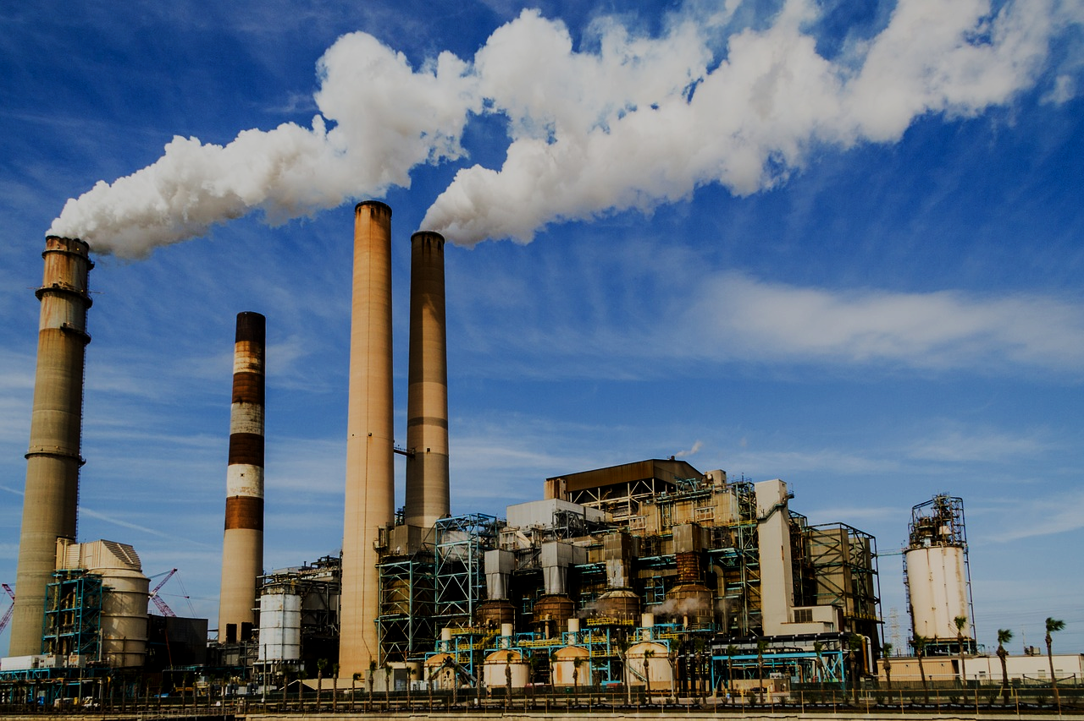
“Whistler”
ENVIRONMENTAL ISSUES
“Whisler”
‘ErrOr404’

Slide 2
Problem Statement:
1
Unethical and Illegal waste disposal practiced by large factories and industries.
2
Unethical indulgence of Government officials with these malpracticing institutions.
3
Unnoticed and neglected reports and complaint lodged by public.

Slide 3
Our Solution:
Addressing the above stated problems, we intend to make a blockchain based web application which can, monitor the waste disposed by registered factories and industries on the application, involve NGOs in the process of inspection, proceed on general public’s complaints on these issues and have a monitoring head that could surveil the whole process.

Slide 4

NGOs: 01
NGOs will work on factory/industry inspection.
------------------------------------------------FUNCTION
They will be assigned random factories each time.
The factories will not be able to predict the NGOs involved in their inspection.
They will have a say in inspection result.
The corruption will be reduced.
QUICK TIP
T

Slide 5

Factories: 02
Factories can be registered by Admin.
-------------------------------------------------FUNCTION
Factories will be inspected randomly by NGOs.
Their inspection data evaluated by NGO and Official, will be stored on blockchain to prevent altering.

Slide 6

Public: 03
To make our goal more exemplary and ideal, the general public can also file complaints.
------------------------------------------------FUNCTION
They can also submit evidence along with complaint, which will be stored on IPFS.
Once complaint is filed, it cannot be tampered with or deleted along with its proof.

Slide 7

Admin: 04
Admin will be governor of the whole process.
They will be the Officials.
-----------------------------------------------FUNCTION
Adding new NGOs/Factories to our application.
All the reports stored on blockchain from each inspection will be received by Admin.
All the complaints stored on blockchain from public will also be received by Admin.
These reports cannot be altered with or deleted.

Slide 8
Thank you!

